Slide 1
Decentralized Asset Exchange
Guided by :
Lathaselvi G
HOD - Information Technology
St Joseph’s College of Engineering
Chennai - 600130
Alfrin Samraj P
312319205006 - Information Technology
St Joseph’s College of Engineering
Chennai - 600130
Jaicharan S
312319205050 - Information Technology
St Joseph’s College of Engineering
Chennai - 600130

Slide 2
Objective of the project
Create a private test Stellar network with the Stellar Core blockchain node and Horizon client/server.
Issue USD, GBP, and EUR assets on our private Stellar network using our issuing account.
Extend trustlines and transfer a "testing" amount of the assets to our receiving/trading accounts. Integrating the real time KYC/AML verification.
Build a frontend that will allow the trading user to log in with their account, view the available offers, and submit buy/sell offers. The frontend will also show us successful trades.

Slide 3
Abstract
Cross-border transactions refer to financial transactions that involve the transfer of money or other assets between individuals, businesses, or financial institutions located in different countries. Traditional cross-border transactions can involve several issues such as high transaction fees, long transaction times, foreign exchange rate fluctuations, and security risks. Blockchain Technology can facilitate more transparent, faster, and efficient cross-border remittance transactions. The proposed system has the tendency of solving the above stated issues effectively based on the regulation. The proposed system converts the initial currency into a different currency for the beneficiary receiving the remittance transaction for the best market price in the market. The effects of middleman roles and fees structure are lessened. The issued assets in the system are ERC-20 token standard verified. The user logins with an approved wallet for exchanging assets. Know Your Customer and Anti Money Laundry are verified using the Distributed ledger Technology(Trustline). The trustline tracks the limit and the amount of credit for which your account trusts the issuing account. All the transactions take place in the stellar network which provides high security, cost and time efficiency. All the transactions are stored in the distributed ledger. Each asset value in the portfolio can be monitored in the real time market and including charts and analysis information.The proposed system is constructed in an user friendly way and the functionalities are well defined for both retail and institutional investors.

Slide 4
Motivation & Problem Statement
Most remittances are made by foreign workers to family members in their home countries. Cross-border payments via a traditional bank transfer normally take between two and five days to process and an electronic payment system through a bank can take as little as ten minutes to reach the recipient. The operational and service fees are expensive.
The reason for fees is due to the number of intermediaries involved in transferring money from one country to another, all of which charge fees for their services. Regulatory costs add up too, while FX fees will also be charged to convert one currency into another.
Cross-border remittances are a complex affair from a compliance and settlement point of view. Banks need to devise complex workflows to carry out compliance checks of the remitter and the beneficiary. The sending bank, receiving bank, and other partner banks need to agree on the compliance requirements of the sender and the receiver before remittance transactions can be executed or credited to the beneficiary.

Slide 5
Literature Survey
S No | Author, Year, Journal, Title | Concept | Pros | Cons
1 | Aleksander Berentsen 2019 - Springer Aleksander Berentsen Recommends “Bitcoin: A Peer-to-Peer Electronic Cash System” by Satoshi Nakamoto | Ideology to create purely peer-to-peer version of electronic cash that would allow online payments to be sent directly from one party to another without going through a financial institution. | Blockchain technology is accessible to all, means anyone can create. | It cannot be scaled as the size of the block is fixed.
2 | Shi-Yi Lin, Lei Zhang 2022 - Springer A survey of application research based on blockchain smart contract | Challenges faced by smart contract with technical issues, analyzes the impact on large-scale applications and mining system on the sustainable development of smart contract, and looks forward to the future research direction of blockchain smart contract. | It stores information in a decentralized manner, so everybody has access | People’s confidence in blockchain technology is low, so investing opportunities are low.
3 | Jakub Zakrzewski 2018 - Springer Towards Verification of Ethereum Smart Contracts: A Formalization of Core of Solidity | Evaluate the feasibility of formalization of Solidity and propose a formalization of a small subset of Solidity that contains its core data model and some unique features, such as function modifiers. | Records or information stored are permanent. | It’s energy consumption makes it unviable for a lot of countries.

Slide 6
Literature Survey
S No | Author, Year, Journal, Title | Concept | Pros | Cons
4 | Nida Khan, Radu State 2019 - Springer Feasibility of Stellar as a Blockchain-Based Micropayment System | conducts a comparison with the micropayment solutions from Bitcoin, Ethereum and PayPal and analyzes a subset of transactions from the Stellar blockchain to enable fraud prevention in online monetary transactions. | Blockchain technology is free from censorship as it doesn’t have control of any single party | It is time consuming to add chain miners and unsuitable for big industrial purposes.
5 | Shi-Yi Lin, Lei Zhang 2021 - Springer An Investigation into Smart Contract Deployment on Ethereum Platform Using Web3.js and Solidity Using Blockchain | Discuss the challenges faced by smart contract with technical issues, analyzes the impact on large-scale applications and mining system on the sustainable development of smart contract and the future research direction of blockchain smart contract. | Blockchain uses hashing techniques to store each transaction on a block. | Blockchain technology applications are banned in some countries due to environmental concerns.
6 | Niki Naderi, Mia Malkova 2021 - Springer Utilizing Blockchain in International Remittances for Poverty Reduction and Inclusive Growth | Support the migration-related SDGs and poverty reduction, it is crucial to utilize recent technological innovations and establish legal channels of remittance transactions. Developing Asia requires to let new players, such as blockchain remittance companies and DLT-based applications, | Blockchain data is immutable and hence cannot be modified | Databases stored on all nodes of the network creates storage issue.

Slide 7
Existing System
The traditional bank transfer normally takes between two and five days to process and an electronic payment system through a bank can take as little as ten minutes to reach the recipient. The operational and service fees are expensive. There are many intermediaries involved in transferring money from one country to another, all of which charge fees for their services. Regulatory costs add up too, while FX fees will also be charged to convert one currency into another. Cross-border remittances are a complex affair from a compliance and settlement point of view. Banks need to devise complex workflows to carry out compliance checks of the remitter and the beneficiary. These parameters make the existing system operationally inefficient and not scalable. Thus, A new innovative system needs to be proposed to solve the shortcomes of the existing system which is in active.

Slide 8
Disadvantage of Existing System
Many banks and other financial institutions have taken steps to close the gap since then, but lots of cross-border payment systems still suffer from the same problems.
High costs of transactional fees
Slow transactions between sender and receiver.
Security issues as the transaction can be compromised.
A lack of transparency due to the complex workflow.

Slide 9
Proposed System
Blockchain technology in cross-border payments can enable secure transfers between an infinite number of bank ledgers. This allows one to bypass banking intermediaries who serve as middlemen to help transfer money from one bank to another. The transaction is secure, quicker, and cheaper and has end-to-end visibility anywhere in the world. The proposed payment system provides user with the best rate suitable for transaction. User can choose their starting and destination assets , and the system will choose the best rates from these exchanges and facilitate the transaction for them. By complying with AML laws, banks can avoid hefty fines and other penalties from regulators while safeguarding their reputation. By ensuring that only verified users can become customers, banks can curb even the most innovative fraud attacks.When banks optimize their KYC/AML flows according to applicant risk profiles, users don’t have to pass extra checks. This reduces drop-offs and improves the user experience.

Slide 10
Advantages of Proposed System
Blockchain is a powerful technology that has the potential to revolutionize cross-border payments. High-quality features such as transparency, enhanced security, data immutability, automatic smart contract execution would help to face the challenges associated with conventional cross-border transactions.
Fast and secure transactions
Easy global payments
Avoids friction among intermediaries
Low transaction fees as it cuts operational cost
More secure and transparent money transfer.

Slide 11
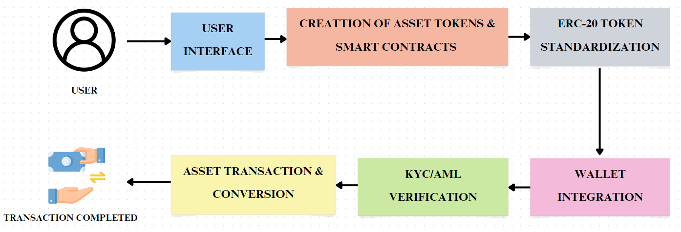
Proposed Architecture Diagram

Slide 12
List of Modules
Stellar Network module
Account module
Asset module
Front end site module
KYC/AML verification module

Slide 13
STELLAR NETWORK
Launch a Stellar network that contains a single blockchain node and a single client/server. The blockchain node in Stellar is called Stellar Core, while the client-server is called Horizon. Horizon is a client API server that extends a suite of handful endpoints, allowing application developers to view transaction data and statistics, and to submit transactions to the core blockchain node. Similar to web3-js, Stellar has a JavaScript SDK that allows us to build requests in order to interact with Horizon. Stellar provides a handy Docker image that can be used to quickly launch an ephemeral (temporary) or persistent (permanent) container for implementing the Stellar network. The Docker container contains an instance of Stellar Core, an instance of Horizon, installed dependencies such as PostgreSQL, and a Go environment.

Slide 14
ACCOUNT
To create our assets and exchange, we need to create our user accounts. Stellar accounts are similar to Ethereum accounts, and they allow users to interact with the Stellar network through transactions. They contain a public key (Account ID) and a secret key or private key, which is used to sign transactions submitted to the ledger. The stellar-sdk provides a utility called Keypair.random, which generates a random ed25519 public-private key pair that can be used as a Stellar account. For a public private key pair to be a valid account on the Stellar network, it needs a minimum balance of 20 lumens. To create an account on our private network, we'll generate a new public-private key pair and fund it with a balance of more than 20 lumens. The Stellar network also requires accounts to submit a "fee" to the network for every transaction, which is paid in lumens. To enable our accounts to create assets and trade, we'll transfer 100,000 lumens to each of the newly generated accounts.

Slide 15
ASSET
To create the currency assets on our private network for trading. You simply need to use the Asset method of the Stellar SDK. The Asset method has two input parameters—asset code and issuer account. Creating an asset object on the Stellar network is an easy affair. The asset code is an alphanumeric code, used to refer to the asset. The issuer account is the account used to create the asset. To create new assets on a network, we need to carry out the following three steps in order:
1. Create a new asset object
2. Extend trustlines to the receiving accounts
3. Transfer the assets from the issuing account.

Slide 16
FRONT END SITE
Build a frontend that will allow the trading user to log in with their account, view the available offers, and submit buy/sell offers. These offers will be recorded on the in-built distributed exchange that the Stellar network provides to us. The frontend will also show us successful trades. The user interface is designed in a way that is self explanatory. Easy to navigate and manage the functionalities provided by the service providers.

Slide 17
KYC/AML VERIFICATION
Know Your Customer (KYC) is the process of obtaining information about the customer and verifying their identity. The scope of identity information to be obtained varies by jurisdiction. Bank need at least the following data such as Name, Date of birth and Residential address. During the verification process, customers provide certain credentials, such as their ID. It’s on the bank to ensure that submitted documents aren’t fake and that customers are who they say they are. KYC/CDD is required in a number of cases described by AML regulations. The module establishes a relationship with a bank for the first time (Opening an account at exchange platform). User makes a transaction exceeding the amount defined by AML regulations. Bank poses suspicions in relation to money laundering/terrorist financing.

Slide 18
S/W Requirement
OS - Windows 10 & Ubuntu
Language used - Solidity
Network Framework - Stellar Core
IDE used - Remix
Ethereum powered Platform

Slide 19
H/W Requirement
System ARM Chipset > 1 GHz
Memory RAM - 512 MB
Disk Space - 350 GB
Download - 250MB / Day
Upload - 5 GB / Day

Slide 20
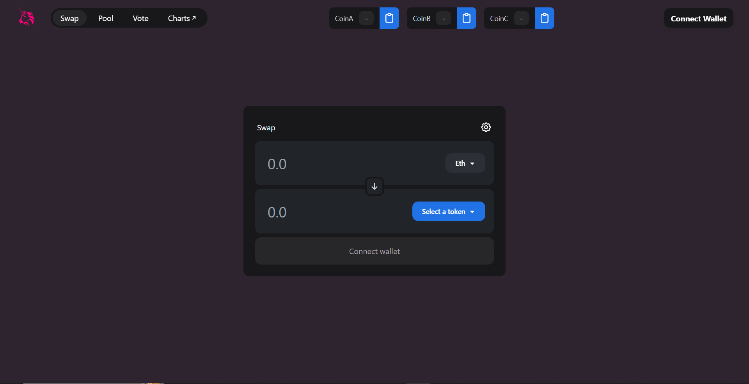
Output Snippet

Slide 21
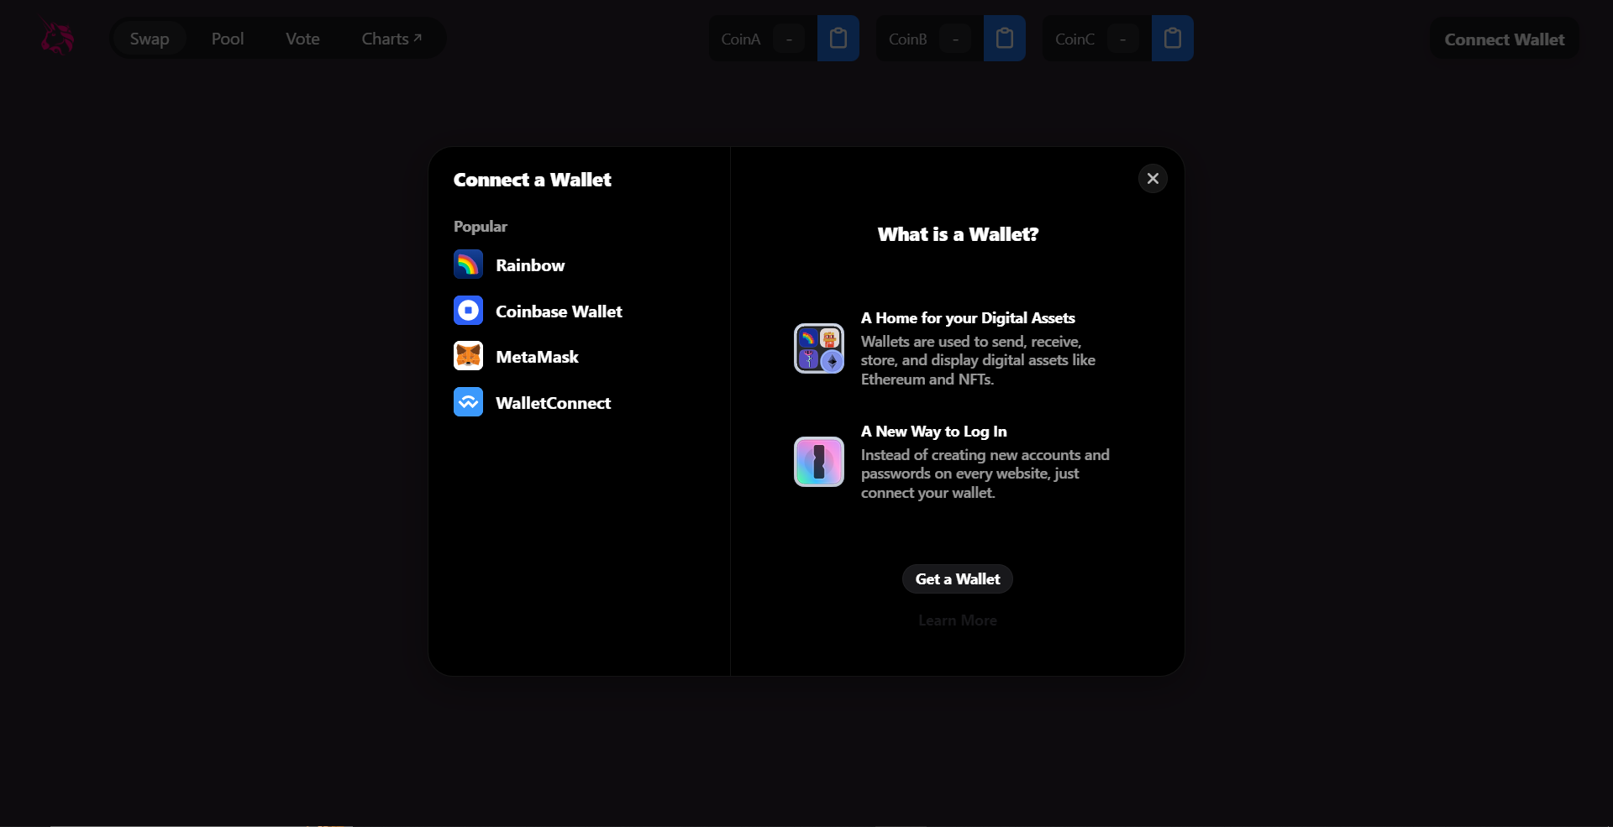
Output Snippet

Slide 22
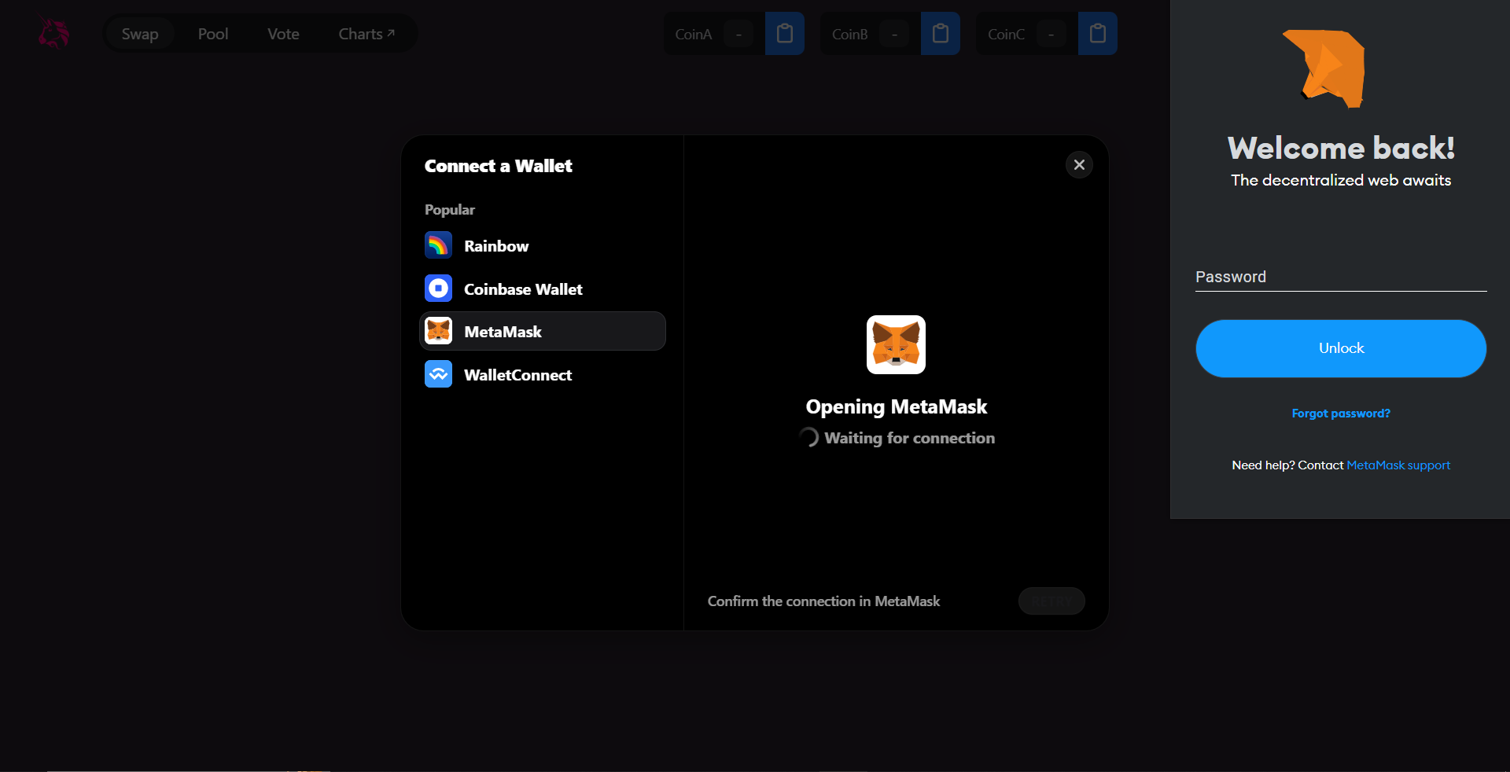
Output Snippet

Slide 23
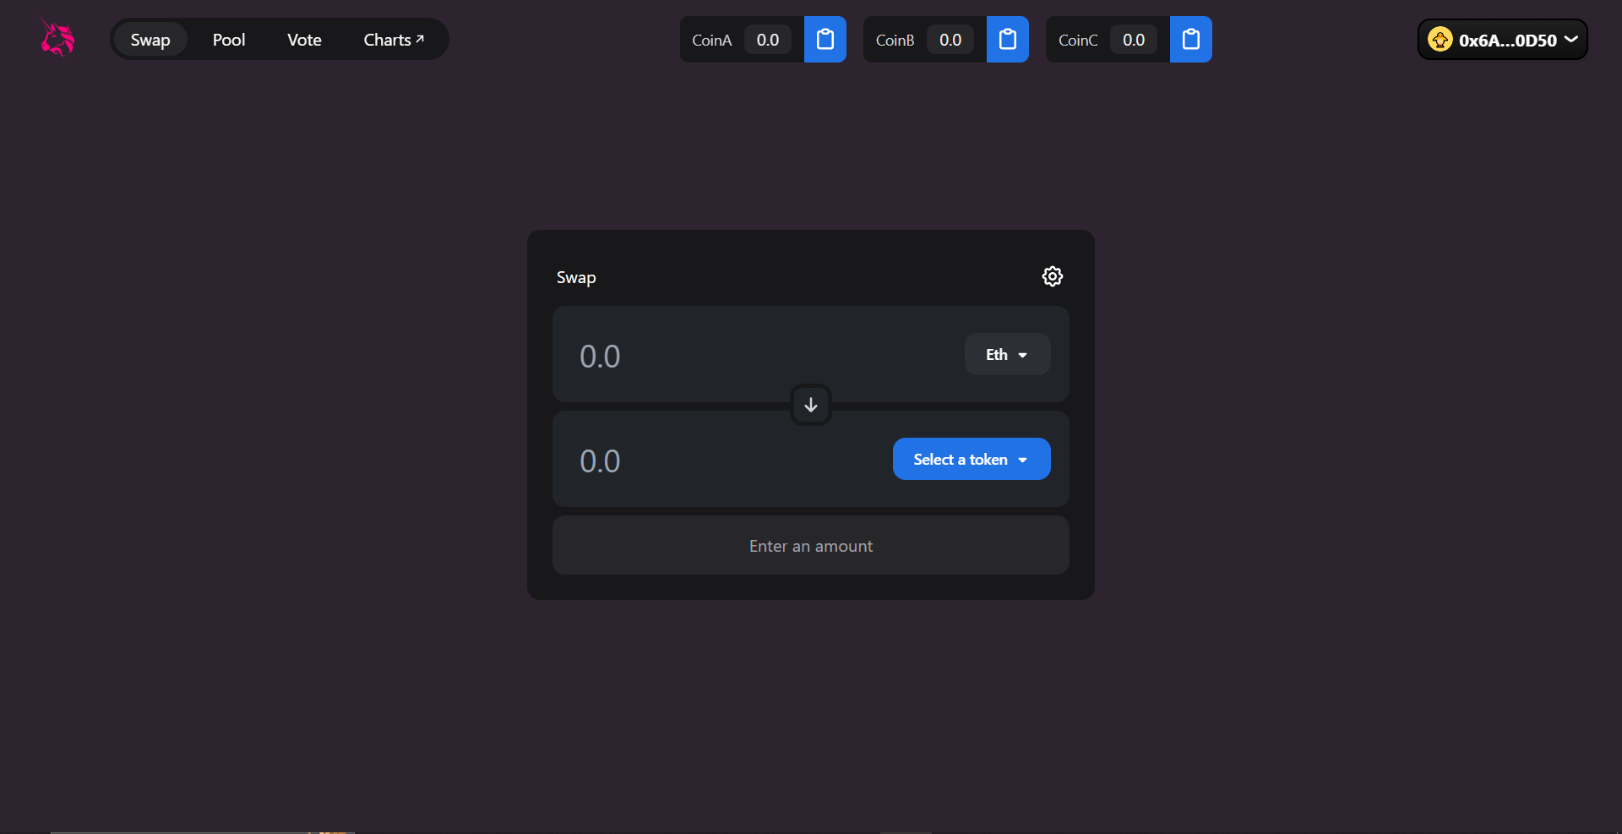
Output Snippet

Slide 24
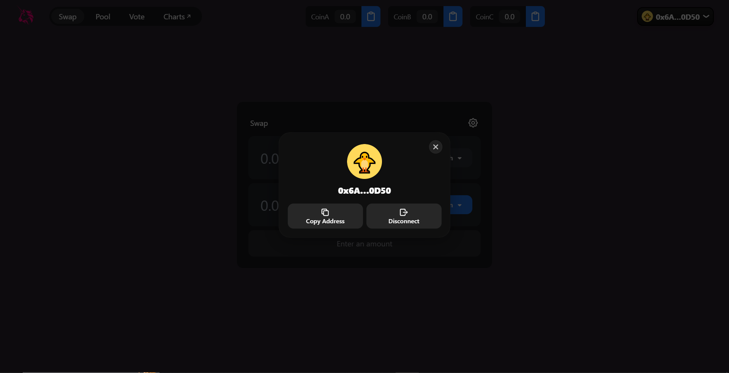
Output Snippet

Slide 25
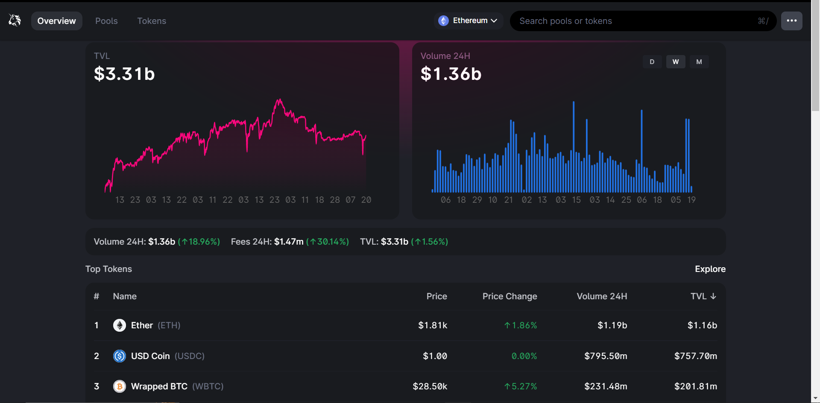
Output Snippet

Slide 26
REFERENCE
[1] - https://link.springer.com/chapter/10.1007/978-3-030-17740-9_3#Abs1
[2] - https://link.springer.com/article/10.1007/s11276-021-02874-x
[3] - https://link.springer.com/chapter/10.1007/978-3-030-03592-1_13
[4] - https://link.springer.com/chapter/10.1007/978-3-030-34083-4_6
[5] - https://link.springer.com/chapter/10.1007/978-981-16-0171-2_52
[6] - https://link.springer.com/chapter/10.1007/978-981-16-1107-0_7

Slide 27
Thank You

